Slide 1
Courtesy : “Engineering a Compiler”, Keith D Cooper & Linda Torczon.

Slide 3
Introduction
Scanning is the first stage of a three-part process that the compiler uses to understand the input program.
The scanner, or lexical analyzer, reads a stream of characters and produces a stream of words.
It aggregates characters to form words and applies a set of rules to determine whether or not each word is legal in the source language.
If the word is valid, the scanner assigns it a syntactic category, or part of speech.
The scanner is the only pass in the compiler that manipulates every character of the input program.
This is an aggregation and classification process

Slide 4
Introduction
To accomplish this aggregation and classification, the scanner applies a set of rules that describe the lexical structure of the input programming language, called as microsyntax.
The microsyntax of a programming language specifies how to group characters into words and, conversely, how to separate words that run together.
Microsyntax – in Programming language
(Almost similar to English’s microsyntax)
Characters are aggregated into words.
Blanks and punctuation marks terminate a word.
Example:
Algol defines identifier as a single alphabetic character followed by zero or more alphanumeric characters.
The identifier ends with the first nonalphanumeric character.
To Note - Set of valid words is specified by rules rather than by enumeration in a dictionary.
Microsyntax – in English language
Adjacent alphabetic letters are grouped together, left to right, to form a word.
A blank space terminates a word.
The word-building algorithm can determine its validity with a dictionary lookup.

Slide 5
Introduction
Keywords such as ‘while’ and ‘int’ are matching with the syntactic category of identifiers.
But compiler should categorize them as ‘keywords’ .
To recognize the ‘keywords’, the compiler can
(1) do a dictionary lookup or
(2) do encode all the keywords in the microsyntax.
The compiler writer must start the work from formulating the specification of the microsyntax for the source language.

Slide 7
Recognizing words
The simplest explanation of an algorithm to recognize words is often a character-by-character formulation.
Consider the problem of recognizing the keyword new.
The code might look like the fragment shown in
Figure 2.1. →→ →
The code tests for n followed by e followed by w.
At each step, the failure reject the string and “try something else.”
The code fragment performs one test per character.
R.H.S shows the simple transition diagram.

Slide 8
Recognizing words
The transition diagram represents a recognizer.
Each circle represents an abstract state in the computation.
Each state is labelled for convenience
The initial state, or start state, is s0.
We will always label the start state as s0.
State s3 is an accepting state; the recognizer reaches s3 only when the input is new.
Accepting states are drawn with double circles,
Using this same approach to build a recognizer for while would produce the following transition diagram:
If it starts in s0 and reaches s5, it has identified the word while.
The corresponding code fragment would involve five nested if-then-else constructs

Slide 9
Recognizing words
To recognize multiple words, we can create multiple edges that leave a given state.
One recognizer for both new and not might be

Slide 10
Recognizing words
We can combine the recognizer for new or not with the one for while by merging their initial states and relabeling all the states.
State s0 has transitions for n and w. The recognizer has three accepting states, s3, s5, and s10.
If any state encounters an input character that does not match one of its transitions, the recognizer moves to an error state.

Slide 11
Recognizing words
A formalism for Recognizer
Transition diagrams serve as abstractions of the code that would be required to implement them.
They can also be viewed as formal mathematical called finite automata, that specify recognizers.
Formally, a finite automaton (FA) is a five-tuple where

Slide 12
Recognizing words
A formalism for Recognizer
As an example, we can cast the FA for new or not or while in the formalism as follows:

Slide 13
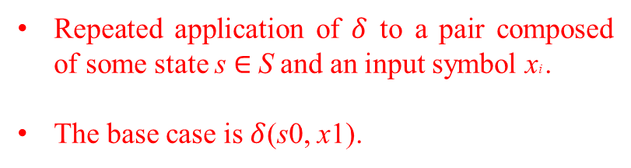
Recognizing words
A formalism for Recognizer
An FA accepts a string x if and only if, starting in s0, the sequence of characters in the string takes the FA through a series of transitions that leaves it in an accepting state when the entire string has been consumed.
Repeated application of $δ$ to a pair composed of some state s $∈$ S and an input symbol xi .
The base case is $δ$(s0, x1).

Slide 14
Recognizing words
A formalism for Recognizer
Two other cases are possible.
(1) The FA might encounter an error while processing the string—that is, some character xj might take it into the error state se. This condition indicates a lexical error; the string x1 x2 x3 . . . x j is not a valid prefix for any word in the language accepted by the FA.
(2) The FA can also discover an error by exhausting its input and terminating in a nonaccepting state other than se.

Slide 15
Recognizing words
Recognizing more complex words
The character-by-character model shown in the original recognizer for not extends easily to handle arbitrary collections of fully specified words.
How could we recognize a number with such a recognizer?
Let us discuss for “unsigned integers” - an integer is either zero, or it is a series of one or more digits where the first digit is from one to nine, and the subsequent digits are from zero to nine.
The transition diagram for this is
For a specific number, such as 113.4, is easy.
However, we need a transition diagram (and the corresponding code fragment) that can recognize any number.

Slide 16
Recognizing words
Recognizing more complex words
The transition s0 → s1 handles the case for zero.
The other path, from s₀ to s₂, to s₃, and so on, handles the case for an integer greater than zero.
This path, however, presents several problems.
First, it does not end, violating the stipulation that S is finite.
Second, all of the states on the path beginning with s2 are equivalent, that is, they have the same labels on their output transitions and they are all accepting states.

Slide 17
Recognizing words
Recognizing more complex words
This transition diagram can be simplified as in RHS, using cycles.
The FA of the simplified one is this
This FA recognizes a class of strings with a common property: they are all unsigned integers.
Syntactic category: ‘unsigned integer’.
Lexeme: a specific unsigned number (Eg. 123)

Slide 18

Recognizing words
Recognizing more complex words
This cyclic transition diagram makes sense as an FA.
In implementation, that cycle in transition needs a cyclic control flow.
We can implement this with a while loop, as shown in Figure 2.2.
We can specify $δ$ efficiently using a table:

Slide 19
Recognizing words
Recognizing more complex words
The columns for the digits 1 through 9 are identical.
We can have only three columns: 0, 1 …9, and other.
It reports failure as soon as it enters se, so it never references that row of the table. We can omit this row.
The simplified table will have just three rows and three columns.

Slide 20
Recognizing words
Recognizing more complex words
We can develop similar FAs for signed integers, real numbers, and complex numbers.
Eg. identifier names in C or Java – “an identifier consists of an alphabetic character followed by zero or more alphanumeric characters”.
This definition allows an infinite set of identifiers, but can be specified with the simple two-state FA shown to the left.
To simplify scanner implementation, we need a concise notation for specifying the lexical structure of words, and a way of turning those specifications into an FA and into code that implements the FA.
These ideas will be discussed next..

Slide 22
Regular Expressions
The set of words accepted by a finite automaton, F, forms a language, denoted L (F).
The transition diagram of the FA specifies that language.
For any FA, we can also describe its language using a notation called a regular expression (RE).
The language described by an RE is called a regular language.

Slide 23
Regular Expressions
Simple RE specifications.
The language consisting of the single word new can be described by an RE written as new.
The language consisting of the two words new or while, write the RE as new | while.
The language consisting of new or not can be described in RE as new | not or n(ew | ot).
Examples REs for programming languages.
Punctuation marks, such as colons, semicolons, commas, and various brackets, can be represented by their character representations. The RE is
RE for keywords
(3) To model more complex constructs, such as integers or identifiers, the RE need to represent the cyclic edges in the FA. (next slide)

Slide 24
Regular Expressions
RE for unsigned integer
The FA for an unsigned integer, shown at the left, has three states: an initial state s0, an accepting state s1 for the unique integer zero, and another accepting state s2 for all other integers.
s2 back to itself that occurs on each additional digit.
The rule is: an unsigned integer is either a zero, or a nonzero digit followed by zero or more digits.
For the RE x, we write this as x*, with the meaning “zero or more occurrences of x.”
(* operator - Kleene closure, or closure)
Using the closure operator, we can write an RE for this FA:

Slide 25
Regular Expressions
Formalizing the Notation
To work with regular expressions in a rigorous way, we must define them more formally.
An RE describes a set of strings over the characters contained in some alphabet, Σ augmented with a character ε that represents the empty string.
We call the set of strings a language.
For a given RE, r, we denote the language that it specifies as L(r).
An RE is built up from three basic operations:

Slide 26
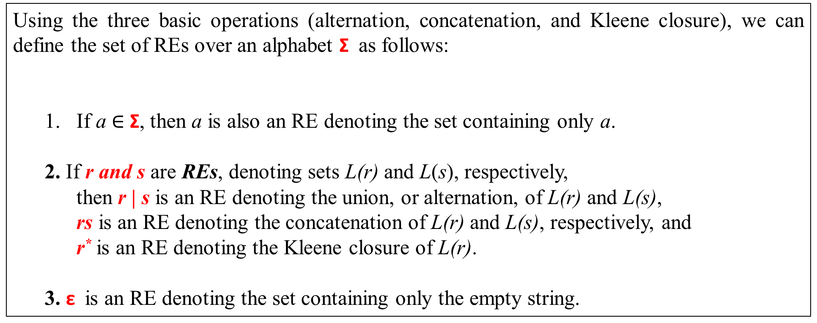
Regular Expressions
Formalizing the Notation
Finite closure - R^{i} – denotes 1 to i occurrence of R. Example R³ = (R | RR | RRR)
Positive closure – R⁺ denotes RR* - that is one or more occurrence of R.
Using the three basic operations (alternation, concatenation, and Kleene closure), we can define the set of REs over an alphabet Σ as follows:
If a $∈$ Σ, then a is also an RE denoting the set containing only a.
2. If r and s are REs, denoting sets L(r) and L(s), respectively,
then r | s is an RE denoting the union, or alternation, of L(r) and L(s),
rs is an RE denoting the concatenation of L(r) and L(s), respectively, and
r* is an RE denoting the Kleene closure of L(r).
3. ε is an RE denoting the set containing only the empty string.

Slide 27
Regular Expressions
Formalizing the Notation
Examples
Some examples of REs from programming languages
identifiers - an alphabetic character followed by zero or more alphanumeric characters,
The RE is ([A. . . Z] | [a. . . z]) ([A. . . Z] | [a. . . z] | [0. . . 9])*
If the length of the identifier is restricted to maximum of 6 character,
The RE is ([A. . . Z] | [a. . . z]) ([A. . . Z] | [a. . . z] | [0. . . 9])⁵
(2) unsigned integer - either zero or a nonzero digit followed by zero or more digits
The RE is 0 | [1. . . 9] [0. . . 9]*
(3) Unsigned real numbers
The RE is (0 | [1. . . 9] [0. . . 9]*) (ε | . [0. . . 9]*)
The first part is just the RE for an integer. The rest generates either the empty string or a decimal point followed by
zero or more digits.
(4) Quoted character strings
Using complement operator, the RE for a character string is “ (ˆ”)* ”.
(5) Comments
The RE is // (ˆ\n)* \n,

Slide 28
Regular Expressions
Formalizing the Notation
Examples
Multiline comments in c, c++, and Java begin with the delimiter /* and end with */.
If we could disallow * in a comment, the RE is simple : simple: /* (ˆ*)**/.
Eg. /* This program is for Matrix Multiplication */
If we allow * in the comments sentence the RE is complex /* ( ˆ* | *⁺ ˆ/ ) */.
Eg. /* The * used in program is to print * triangle */
The Corresponding FA is

Slide 29
Regular Expressions
Formalizing the Notation
Examples
(7) Unlimited set of register names
The RE is r[0. . . 9]⁺
This recognizer accepts r29, and rejects s29. It also accepts r99999.
The RE for register numbering from r0 to r31 is r ( [0. . . 2] ([0. . . 9] | ε ) | [4. . . 9] | (3 (0 | 1 | ε )) )
It accepts r0, r00, r01, and r31, but rejects r001, r32, and r99999.
The corresponding FA:
Alternate RE for r0 to r31 is

Slide 30
Regular Expressions
Formalizing the Notation
Closure properties of RE
REs have many interesting and useful properties, which are playing a critical role in the constructions that build recognizers from REs.
Regular expressions are closed under many operations—that is, if we apply the operation to an RE or a collection of REs, the result is an RE.
Obvious examples are concatenation, union, and closure.

Slide 32
FROM REGULAR EXPRESSION TO SCANNER
The goal with finite automata is to automate the derivation of executable scanners from a collection of REs.
We will discuss the constructions that transform an RE into an FA that is suitable for direct implementation and an algorithm that derives an RE for the language accepted by an FA.
Figure 2.3 shows the relationship between all of these constructions.
Will discuss deterministic FAs, or DFAs, and nondeterministic FAs, or NFAs.
Construction of a DFA from an RE in three steps.
(1) Thompson’s construction - derives an NFA from an RE.
(2) The subset construction - builds a DFA that simulates an NFA.
(3) Hopcroft’s algorithm - minimizes the DFA.
Kleene’s construction derives an RE from a DFA.

Slide 33
FROM REGULAR EXPRESSION TO SCANNER
Nondeterministic Finite Automata - NFA
Recall from the definition of an RE and FA that
- We designated the empty string, ε , as an RE.
- None of the FAs included ε.
What role does ε play in an fa?
We can use transitions on ε to combine FAs and form new FAs for more complex REs.
For example, assume that we have FAs for the REs m and n, called FAm and FA_{n}, respectively.
We can build an FA for mn by adding a transition on ε from the accepting state of FAm to the initial state of FAn, renumbering the states, and using FAn’s accepting state as the accepting state for the new FA.

Slide 34
FROM REGULAR EXPRESSION TO SCANNER
Nondeterministic Finite Automata - NFA
we can combine s1 and s2 to eliminate the ε transition.
Merging two FAs with an ε transition can complicate our model of how FAs work.
Consider the FAs for the languages a* and ab.
We can combine them with an ε -transition to form an FA for a*ab.

Slide 35
FROM REGULAR EXPRESSION TO SCANNER
NFA & DFA
The correct transition out of s0 on a depends on the characters that follow the a.
An FA that includes states such as s0 that have multiple transitions on a single character is called a nondeterministic finite automaton (NFA).
An FA with unique character transitions in each state is called a deterministic finite automaton (DFA).

Slide 36
FROM REGULAR EXPRESSION TO SCANNER
NFA & DFA

Slide 37
FROM REGULAR EXPRESSION TO SCANNER
NFA
There are two distinct models available for describing the behavior of an NFA.
Each time the NFA must make a nondeterministic choice, it follows the transition that leads to an accepting state for the input string, if such a transition exists.
In essence, the NFA guesses the correct transition at each point.
(2) Each time the NFA must make a nondeterministic choice, the NFA clones itself to pursue each possible transition.
- Thus, for a given input character, the NFA is in a specific set of states, taken across all of its clones.
- In this model, the NFA pursues all paths concurrently.
-At any point, we call the specific set of states in which the NFA is active as its configuration.
- When the NFA reaches a configuration in which it has exhausted the input and one or more of the clones has reached an accepting state, the NFA accepts the string.

Slide 38
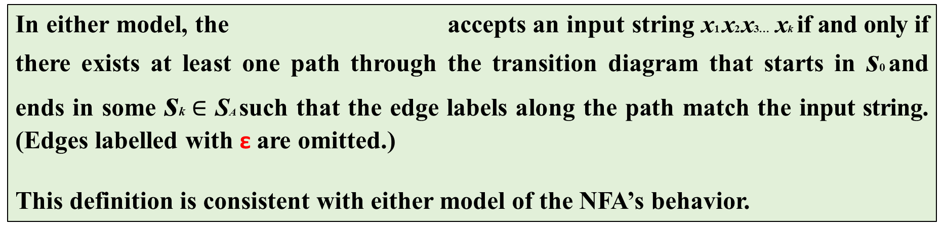
FROM REGULAR EXPRESSION TO SCANNER
NFA & DFA
In either model, the accepts an input string x1 x2 x3… xk if and only if there exists at least one path through the transition diagram that starts in s0 and ends in some sk $∈$ SA such that the edge labels along the path match the input string. (Edges labelled with ε are omitted.)
This definition is consistent with either model of the NFA’s behavior.
for a*ab – The NFA.
NFAs and DFAs are equivalent in their expressive power.
Any DFA is a special case of an NFA.
Any NFA can be simulated as a DFA.
for a*ab – The DFA.

Slide 39
FROM REGULAR EXPRESSION TO SCANNER
Regular Expression to NFA: Thompson’s Construction
The first step in moving from an RE to an implemented scanner must derive an NFA from the RE.
Thompson’s construction is used for this.
It has a template for building the NFA that corresponds to a single-letter RE, and a transformation on NFAs that models the effect of each basic RE operator: concatenation, alternation, and closure.
This figure shows the trivial NFAs for the REs a and b, as well as the transformations to form NFAs for the REs ab, a|b, and a* from the NFAs for a and b.

Slide 40
FROM REGULAR EXPRESSION TO SCANNER
The construction begins by building trivial NFAs for each character in the input RE.
Next, it applies the transformations for alternation, concatenation, and closure to the collection of trivial NFAs in the order dictated by precedence and parentheses.

Slide 41
FROM REGULAR EXPRESSION TO SCANNER
Regular Expression to NFA: Thompson’s Construction
Construction of NFA for the RE a(b|c)*
(1) first build NFAs for a, b, and c.
(2) parentheses - build the NFA for (b|c)
(3) closure – build the NFA for (b|c)*
(4) finally, concatenate the NFA for a to the
NFA for (b|c)*.

Slide 42
FROM REGULAR EXPRESSION TO SCANNER
Regular Expression to NFA: Thompson’s Construction
The NFAs derived from Thompson’s construction have several specific properties
Each NFA has one start state and one accepting state.
No transition, other than the initial transition, enters the start state.
No transition leaves the accepting state.
An ε -transition always connects two states that were, earlier in the process, the start state and the accepting state of NFAs for some component REs.
Finally, each state has at most two entering and two exiting ε-moves, and at most one entering and one exiting move on a symbol in the alphabet.
Together, these properties simplify the representation and manipulation of the NFAs.

Slide 43
FROM REGULAR EXPRESSION TO SCANNER
NFA to DFA: The Subset Construction
The algorithm that constructs a DFA from an NFA is called the subset construction.
DFAs have a simple execution model and several efficient implementations.
The NFA and the DFA use the same alphabet, Σ.
The DFA’s start state, d0, and its accepting states, DA, will emerge from the construction.
The complex part of the construction is the derivation of the set of DFA states D from the NFA states N, and the derivation of the DFA transition function δD.

Slide 44
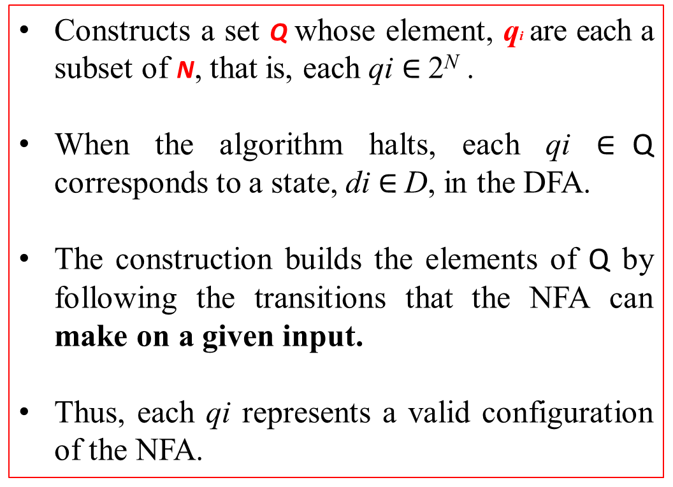
FROM REGULAR EXPRESSION TO SCANNER
NFA to DFA: The Subset Construction
Constructs a set Q whose element, qi are each a subset of N, that is, each qi $∈$ 2^{N} .
When the algorithm halts, each qi $∈$Q corresponds to a state, di $∈$ D, in the DFA.
The construction builds the elements of Q by following the transitions that the NFA can make on a given input.
Thus, each qi represents a valid configuration of the NFA.

Slide 45
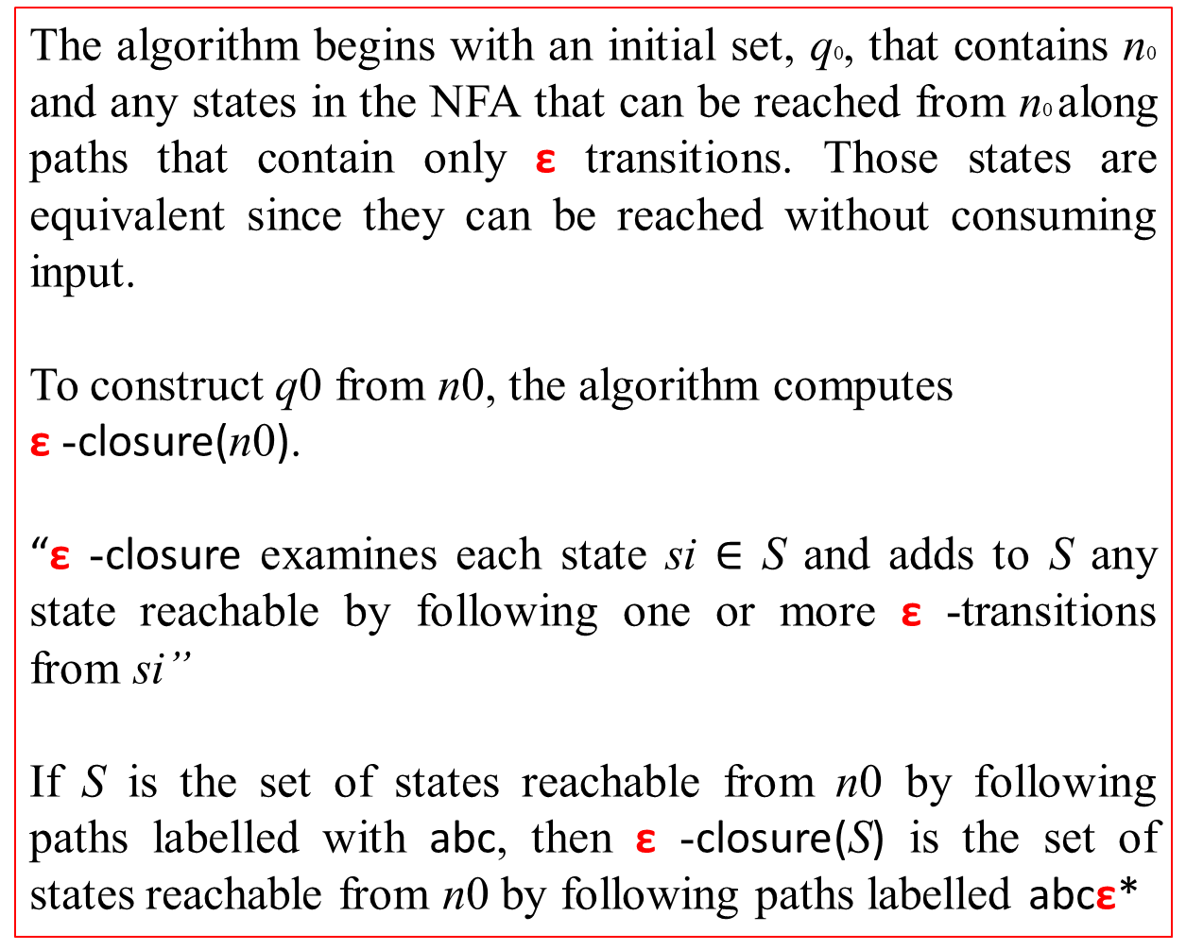
FROM REGULAR EXPRESSION TO SCANNER
NFA to DFA: The Subset Construction
The algorithm begins with an initial set, q0, that contains n0 and any states in the NFA that can be reached from n0 along paths that contain only ε transitions. Those states are equivalent since they can be reached without consuming input.
To construct q0 from n0, the algorithm computes
ε -closure(n0).
“ε -closure examines each state si $∈$ S and adds to S any state reachable by following one or more ε -transitions from si”
If S is the set of states reachable from n0 by following paths labelled with abc, then ε -closure(S) is the set of states reachable from n0 by following paths labelled abcε*
Initially, Q has only one member, q0 and the WorkList contains q0.

Slide 46
FROM REGULAR EXPRESSION TO SCANNER
NFA to DFA: The Subset Construction
The algorithm proceeds by removing a set q from the worklist.
Each q represents a valid configuration of the original NFA.
The algorithm constructs, for each character c in the alphabet Σ, the configuration that the NFA would reach if it read c while in configuration q.
This computation uses a function Delta(q, c) that applies the NFA’s transition function to each element of q.
It returns

Slide 47
FROM REGULAR EXPRESSION TO SCANNER
NFA to DFA: The Subset Construction
The while loop repeatedly removes a configuration q from the worklist and uses Delta to compute its potential transitions.
It augments this computed configuration with any states reachable by following ε -transitions, and adds any new configurations generated in this way to both Q and the worklist.
When it discovers a new configuration t reachable from q on character c, the algorithm records that transition in the table T.
The inner loop, which iterates over the alphabet for each configuration, performs an exhaustive search.

Slide 48
FROM REGULAR EXPRESSION TO SCANNER
NFA to DFA: The Subset Construction
Notice that Q grows monotonically. The while loop adds sets to Q but never removes them.
Since the number of configurations of the NFA is bounded and each configuration only appears once on the worklist, the while loop must halt.
When it halts, Q contains all of the valid configurations of the NFA and T holds all of the transitions between them.

Slide 49
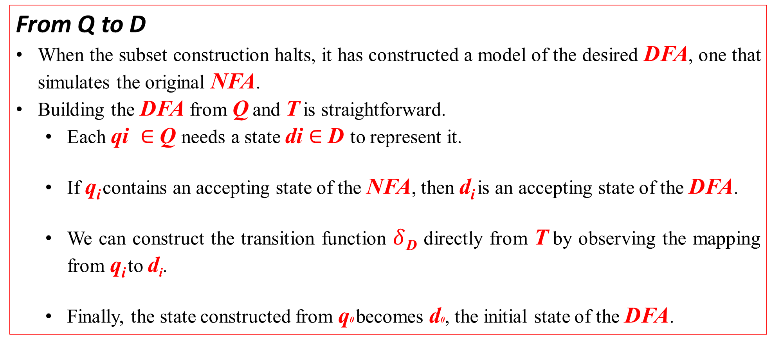
FROM REGULAR EXPRESSION TO SCANNER
NFA to DFA: The Subset Construction
From Q to D
When the subset construction halts, it has constructed a model of the desired DFA, one that simulates the original NFA.
Building the DFA from Q and T is straightforward.
Each qi $∈$Q needs a state di $∈$D to represent it.
If q_{i} contains an accepting state of the NFA, then d_{i} is an accepting state of the DFA.
We can construct the transition function $δ$_{D} directly from T by observing the mapping from q_{i} to d_{i}.
Finally, the state constructed from q0 becomes d0, the initial state of the DFA.

Slide 50
FROM REGULAR EXPRESSION TO SCANNER
NFA to DFA: The Subset Construction
Example - Consider the NFA built for a(b|c)* with its states renumbered.
The table sketches the steps that the subset construction follows.
The first column shows the name of the set in Q being processed in a given iteration of the while loop.
The second column shows the name of the corresponding state in the new DFA.
The third column shows the set of NFA states contained in the current set from Q.
The final three columns show results of computing the ε-closure of Delta on the state for each character in Σ.

Slide 51
FROM REGULAR EXPRESSION TO SCANNER
NFA to DFA: The Subset Construction

Slide 52
FROM REGULAR EXPRESSION TO SCANNER
NFA to DFA: The Subset Construction
In DFA - the states correspond to the DFA states from the table.
the transitions are given by the Delta operations that generate those states.
since the sets q₁, q₂ and q₃ all contain n₉ (the accepting state of the NFA), all three become accepting states in the DFA.

Slide 53
FROM REGULAR EXPRESSION TO SCANNER
DFA to Minimal DFA: Hopcroft’s Algorithm
The DFA that emerges from the subset construction can have a large set of states.
To minimize the number of states in a DFA, we need a technique to detect when two states are equivalent—that is, when they produce the same behavior on any input string.
The below algorithm finds equivalence classes of DFA states based on their behavior.
From those equivalence classes, we can construct a minimal DFA.

Slide 54
FROM REGULAR EXPRESSION TO SCANNER
DFA to Minimal DFA: Hopcroft’s Algorithm
Consider a DFA that recognizes the language fee | fie
By inspection, we can see that states s₃ and s₅ serve the same purpose. Both are accepting states entered only by a transition on the letter e.
Neither has a transition that leaves the state.
We would expect the DFA minimization algorithm to discover this fact and replace them with a single state.

Slide 55
FROM REGULAR EXPRESSION TO SCANNER
DFA to Minimal DFA: Hopcroft’s Algorithm
Another Example
Consider the DFA for a (b | c)*
The minimal DFA

Slide 56
FROM REGULAR EXPRESSION TO SCANNER
Using a DFA as a Recognizer
Thus far, we have developed the mechanisms to construct a DFA from a single RE.
To be useful, a compiler’s scanner must recognize all the syntactic categories that appear in the grammar for the source language.
What we need, then, is a recognizer that can handle all the REs for the language’s microsyntax.
Given the REs for the various syntactic categories, r1, r2, r3, . . . , rk , we can construct a single re for the entire collection by forming (r₁ | r₂ | ... | r_{k}).
We run this RE through the entire process, build an NFA, construct a DFA, minimize it, and turn the minimal DFA into executable code, the resulting code is the SCANNER.
This scanner will recognize the given input word to match to one of the r_{i}.

Slide 58
IMPLEMENTING SCANNERS
Three implementation strategies for converting a DFA into executable code:
(1) table-driven scanner,
(2) direct-coded scanner, and
(3) hand-coded scanner.
All of these scanners operate in the same manner, by simulating the DFA.
(1) They repeatedly read the next character in the input and simulate the DFA transition caused by that character.
(2) This process stops when the DFA recognizes a word.
2.1) it occurs when the current state, s, has no outbound transition on the current input character.
2.2) now, if s is an accepting state,
2.2.a) then the scanner recognizes the word and returns a lexeme and its syntactic category.
2.2.b) else if s is a nonaccepting state,
then the scanner rollback and check is there any accepting state during its transition
2.2.b.1) if found an accepting state then ‘report success’
else ‘report failure’ .

Slide 59
IMPLEMENTING SCANNERS
Table-Driven Scanners
The table-driven approach uses a skeleton scanner for control and a set of generated tables that encode language-specific knowledge.
As shown in Figure 2.13, the compiler writer provides a set of lexical patterns, specified as regular expressions.
The scanner generator then produces tables that drive the skeleton scanner.

Slide 60
the tables for r [0. . . 9]⁺ and the underlying DFA.
the skeleton scanner

Slide 61
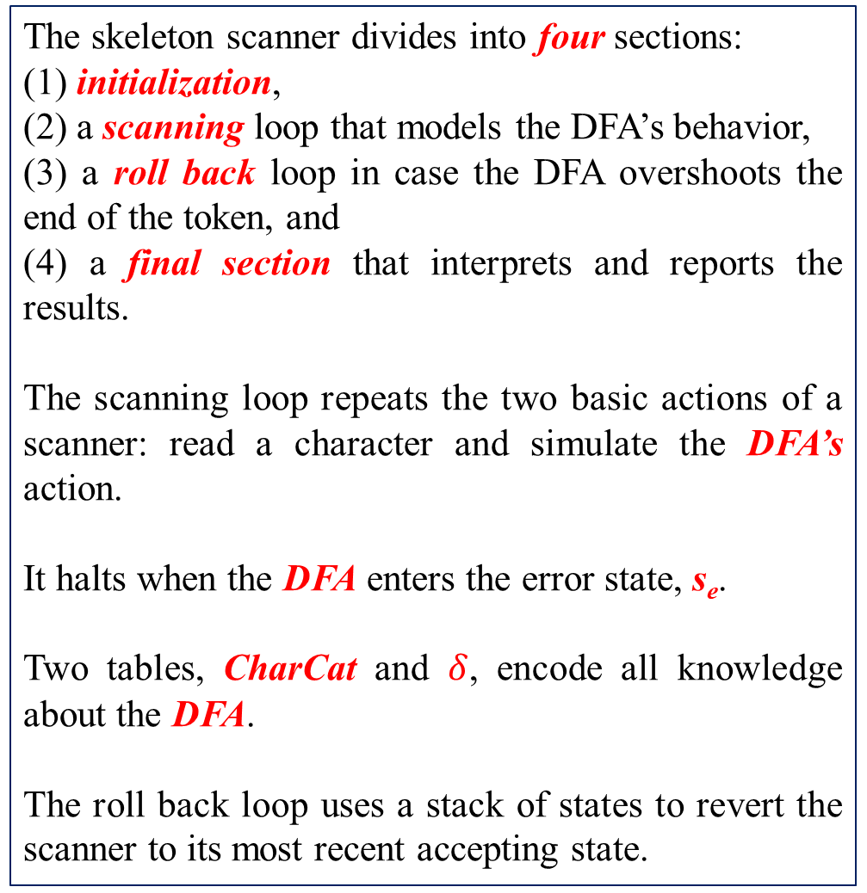
the skeleton scanner
The skeleton scanner divides into four sections:
(1) initialization,
(2) a scanning loop that models the DFA’s behavior,
(3) a roll back loop in case the DFA overshoots the end of the token, and
(4) a final section that interprets and reports the results.
The scanning loop repeats the two basic actions of a scanner: read a character and simulate the DFA’s action.
It halts when the DFA enters the error state, s_{e}.
Two tables, CharCat and $δ$, encode all knowledge about the DFA.
The roll back loop uses a stack of states to revert the scanner to its most recent accepting state.

Slide 62
the skeleton scanner
The skeleton scanner uses the variable state to hold the current state of the simulated DFA.
It updates state using a two-step, table-lookup process.
First, it classifies char into one of a small set of categories using the CharCat table.
The scanner for r [0. . . 9]+ has three categories: Register, Digit, or Other.
(2) Next, it uses the current state and the character category as indices into the transition table, .
This two-step translation, character to category, then state and category to
new state, lets the scanner use a compressed transition table.

Slide 64
Thank you…

